Slide 1
ReneWind
PGP-AIML-BA-UTA-Jun25-D
Date: 11/01/2025
Yashpal Singh

Slide 2
Contents / Agenda
Executive Summary
Business Problem Overview and Solution Approach
Data Overview
EDA Results
Data Preprocessing
Model Evaluation Criterion
Model Performance Summary
Test Performance of Best Model
Appendix

Slide 3
Executive Summary
The ReneWind project successfully developed and validated a cost-weighted Deep Learning classification model (Model 8) to create a proactive early warning system for wind turbine generator failures, addressing the company's highest single maintenance cost event.
The core business problem was an unacceptable reliance on a reactive maintenance strategy, where missed or late detection of failures (False Negatives) necessitates expensive generator replacements. The project's success criterion was defined as maximizing the model's ability to detect imminent failures (Recall) to consistently trigger low-cost, scheduled repairs.
The final model, a Shallow Feedforward Deep Neural Network (40->20->10 architecture) optimized with the SGD Optimizer and cost-weighted training, demonstrated strong generalization with minimal overfitting
Metric | Result | Observation
Primary Metric (Recall) | 0.935 | Strong ability to capture true positive events, aligning with the primary objective..
Precision | 0.925 | Stable across training , validation and Testing
Minority Class (Failure) F1 Score | 0.86 | Represents a reliable balance between sensitivity (Recall) and precision, confirming a low rate of excessive false alarms.
Minority Class (Failure) Recall | 0.87 | The critical metric indicating the system’s effectiveness at minimizing the most costly errors (False Negatives).
Conclusion: Model 8 is production-ready and achieves a highly desirable Recall for the minority failure class (0.87) while maintaining high overall performance and stability.

Slide 4
Executive Summary-Actionable Insights
Cost-Weighted Strategy is Validated: The rationale to prioritize Recall was sound, as False Negatives (missed failures leading to replacement) are the most expensive error, justifying the model's design around minimizing these misses
High Data Quality for Deep Learning: Exploratory Data Analysis (EDA) confirmed that the majority of input features (V1-V20) are highly standardized and follow a classic normal distribution with symmetrical outliers. This near-ideal structure simplified preprocessing and ensured the suitability of a Deep Neural Network, maximizing its learning potential
Effective Imbalance Mitigation: The implementation of cost-weighted training successfully biased the model toward the rare, critical failure class, which was essential for achieving the high Recall score (0.87) that drives the projected cost savings
Generalization is Robust: The model exhibits minimal generalization gap and consistent performance across all evaluation stages (Training, Validation, and Test sets), indicating high stability and predictive integrity for deployment into live operations

Slide 5
Executive Summary-Recommendations
Immediate Production Deployment: Deploy Model 8 immediately to transition the maintenance paradigm from reactive to proactive. Leverage the validated high Recall (0.87) to begin scheduling repairs and capturing the critical reduction in operational expenditure (OPEX)
Implement a Multi-Tier Alerting Protocol: Do not treat all positive predictions the same. Establish a tiered system based on the model's output probability to manage cost:
      High Probability Alert: Trigger an immediate, scheduled, low-cost Repair (True Positive).
    Medium Probability Alert: Trigger a non-emergency Inspection to confirm the finding (False Positive mitigation).
3. Establish Continuous Monitoring and Retraining: Implement a live monitoring dashboard to track the model's performance on new incoming data, specifically tracking Recall drift. Plan for quarterly or semi-annual retraining cycles using fresh, labeled data to adapt to any concept drift or changes in turbine operating conditions.

Slide 6
Problem Statement : Proactive Generator Failure of Wind Turbines Mitigation
The Problem : Unacceptable Operational Risk and Cost
ReneWind currently faces significant and unavoidable operational expenditure (OPEX) due to a reactive maintenance strategy for critical wind turbine generators. When a failure is missed or detected too late, the resulting catastrophic breakdown necessitates an expensive generator replacement, which is the highest single cost event in our maintenance portfolio. This costly scenario represents our greatest financial vulnerability and compromises asset uptime.
The Objective: Cost-Weighted Predictive Intelligence
The goal of this initiative is to leverage advanced Machine Learning classification models and our proprietary sensor data to build a precision early warning system. The system must prioritize the prevention of catastrophic failures above all else.
The Business Imperative :We must immediately shift our maintenance paradigm to a proactive one by implementing a model optimized to maximize detection (Recall) of imminent failures. The ultimate measure of success is the model's ability to consistently trigger low-cost, scheduled repairs (Repairing Cost), thereby mitigating the occurrence of high-cost replacements and dramatically reducing overall generator maintenance OPEX.

Slide 7
Solution Approach - Deep Learning Classification
Goal &
Objective
Data quality assurance
Explanatory Data analysis
Identification of perfect performance Metric
Modeling Strategy
Baseline & Sample Model
Increment in hidden layer
Regularization check
Addressing Imbalance
Optimizer Changes
Increment of Neurons
Final Model Selection
Test Data Validation

Slide 8
Solution Approach - Deep Learning Classification
Project Goal & Objectives:
To leverages a multi-phase Deep Learning approach to deliver a robust, cost-weighted early warning system
Data Analysis and Preprocessing :
Data Analysis:.
Identified the target variable (Target) and selected relevant predictor features for model development.
Performed data cleaning by handling missing values (imputation/removal), correcting data types, and addressing outliers to ensure dataset consistency and reliability.
EDA:
Conduct univariate and bivariate analysis to understand feature distributions and relationships with the target variable.
Detect potential outliers and data skewness using visualization techniques.
Generate a correlation heatmap to analyze inter-feature relationships and their influence on the target variable.
Feature Engineering:
Develop new derived features to enhance model predictability and capture complex patterns.
Apply categorical encoding (One-Hot Encoding / Label Encoding) if required .
Data Splitting
Split the labeled data into 80% Train , 20% Validations and a separate hold-out Test Set, ensuring all splits are stratified by the target variable to maintain class balance.
Modeling Strategy/Comprehensive Classification:
Baseline & Simple Models:
Establish a baseline performance metric using a simple Neural Network (Model 0/1) with ReLU activation and SGD optimizer,
trained on the Train set and evaluated on the Validation set.
Model performance Improvement
Increase the the number of hidden layers , adjust the neurons and validate for the improved performance
Introducing Regularization:
Set the dropout to 50% after adding the first hidden layer. This step will randomly drop 50% of the neurons before proceeding to the next layer, reducing overfitting.
Addressing Imbalance :
Implement cost-weighted training (using class weight dictionary) to bias the model towards the minority failure class, directly optimizing for high Recall and mitigating the high cost of False Negatives.

Slide 9
Solution Approach - Deep Learning Classification
Use of the Adam Optimizer:
We will rebuild the existing models, replacing the current optimizer with the Adam Optimizer to evaluate and quantify any resulting performance improvements.
Increase the Number of Neurons:
We will select the currently best-performing model and rebuild a new iteration using the same parameters, but increasing the number of neurons in each layer to explore improved feature learning capacity.
Model Selection Criteria
Select the best model based on the highest Validation Set Recall, while ensuring a stable F1 Score and minimal degradation (overfitting) compared to the Training Set.
Step by Step Model Evaluation
  Comparison of Training and Validations primary metric Recall and check highest Recall and minimum recall gap and identified top 4 Model
  Verify Top precision for stability
  Verify F1 Score as balance check and identify highest score
  Based on above identify the final model
Final Validation :
Test the finalized model on the entirely unseen Test Set to obtain an unbiased estimate of real-world performance.
Observe the test data results

Slide 10
Selection of Best Primary Metric
The best primary metric to optimize the machine learning model, based on the cost structure and objective, is Recall.
Rationale for Choosing Recall: The Objective is to identify failures before they happen to reduce the overall maintenance cost. The key to this is understanding the costs associated with the different types of prediction errors:
False Negatives : Real failure missed by the model
  Result : Replacement cost
False Positive
  Result : Inspection Cost
True Positive : Correctly predicted failure
  Result : Repairing Cost
Cost Analysis : Replacement cost>> Repairing Cost >>Inspection Cost
The most expensive error by far is a False Negative (FN), which leads to a replacement cost. The goal is to minimize the number of missed failures (FNs), as they have the highest financial impact and this justifies the Recall is the best primary metric for the selection of the best model and Precision should be used as a secondary metric. The goal should be to achieve the highest possible Recall while keeping Precision at an acceptable level to avoid excessive inspection costs from False Positives.

Slide 11
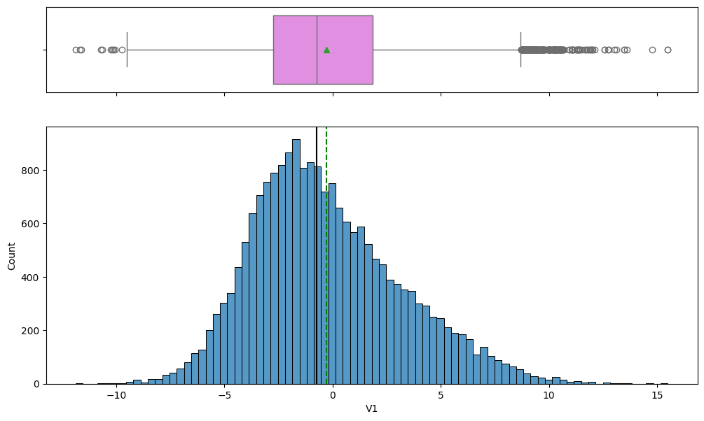
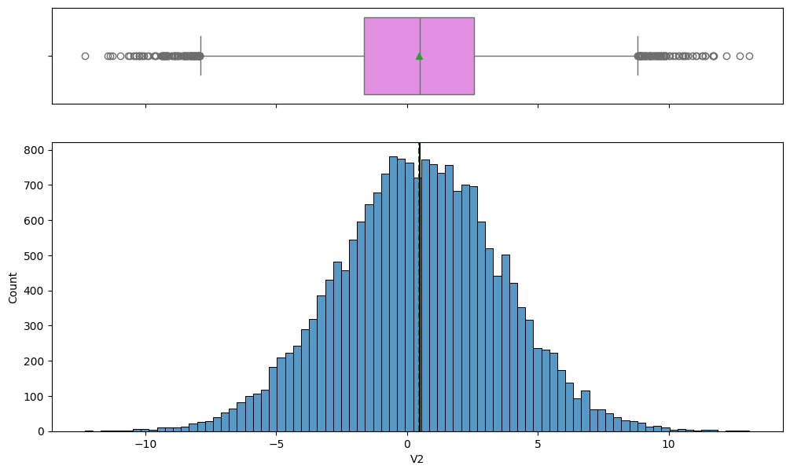
EDA Results- Univariate analysis
Below box and histogram plots shows the distribution and statistics for feature V1 and V2.
Key Observations –V1
Near-normal distribution: The feature follows a bell-shaped pattern, indicating it is likely normalized or standardized, making it suitable for neural network training.
Slight negative skew: The mean is slightly to the right of the median, and the left tail is marginally longer, suggesting a minor negative skew.
Presence of outliers: The box plot shows multiple points extending beyond the whiskers on both positive and negative ends, indicating the presence of mild and extreme outliers.
Key Observations –V2
Ideal standardization or normalization: The feature is centered close to zero with mean approximately equal to median and shows a symmetrical bell-shaped distribution, indicating good standardization for neural network input.
Minimal skewness: The mean and median are nearly aligned, confirming that the distribution has negligible skewness.
Well-tamed outliers: Although outliers are present, they are symmetrically distributed on both sides, suggesting they were properly handled during preprocessing or can be effectively managed by the model.

Slide 12
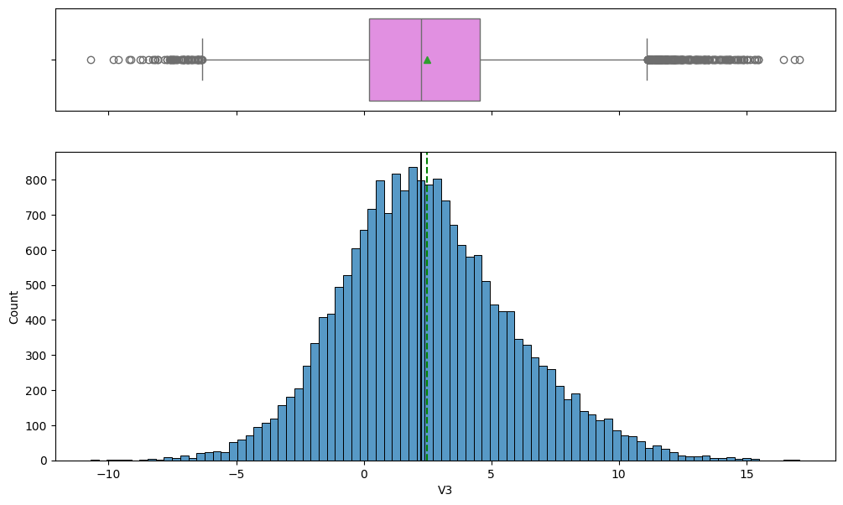
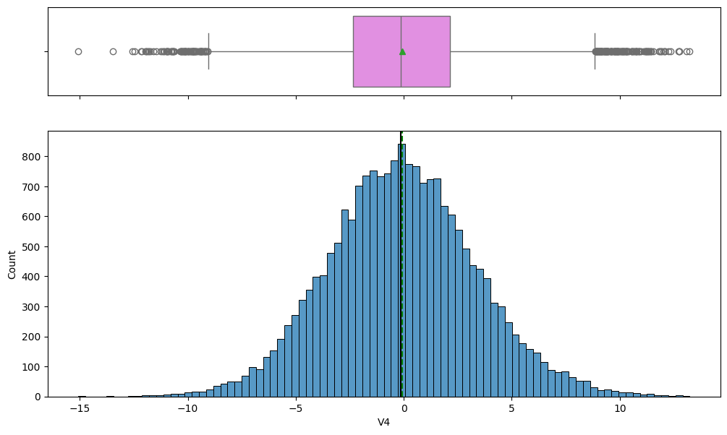
EDA Results- Univariate analysis
Below box and histogram plots shows the distribution and statistics for feature V3 and V4.
Key Observations –V3
Slight positive skew: The distribution is mostly bell-shaped, but the mean is slightly to the right of the median, indicating a minor positive skew.
Broad distribution or variance: The histogram spans a wide range, approximately from -10 to +15, suggesting this feature has higher variance compared to V2 while remaining centered near zero.
Symmetrical outliers: Outliers are present on both sides of the box plot whiskers but appear symmetrically distributed, which supports model stability.
Key Observations –V4
High level of standardization: The distribution is highly symmetrical and centered around zero, with the mean approximately equal to the median, indicating optimal standardization.
Classic normal distribution: The histogram shows a clear bell-shaped pattern, confirming that the feature closely follows a standard normal distribution.
Well-defined outliers: Outliers appear on both ends of the box plot but are symmetrically distributed, suggesting they are natural variations within the data rather than severe anomalies.

Slide 13

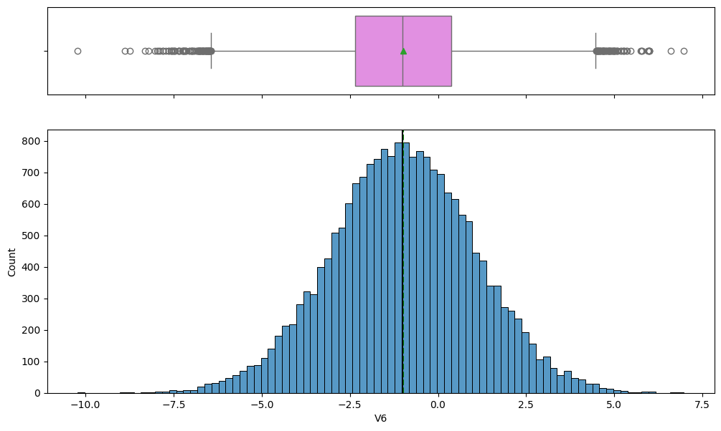
EDA Results- Univariate analysis
Below box and histogram plots shows the distribution and statistics for feature V5 and V6.
Key Observations –V5
Centered and symmetrical: The distribution is highly symmetrical and centered near zero, with the mean and median almost identical, indicating optimal standardization.
Lowest outlier presence: Compared to V1 through V4, the V5 box plot shows fewer extreme outliers on the left side, suggesting a cleaner and more stable data range.
Ideal input distribution: The feature closely approximates a standard normal distribution, making it an ideal input for deep learning models with minimal need for additional preprocessing.
Key Observations –V6
High symmetry and centering: The distribution is highly symmetrical and centered near zero, with the mean approximately equal to the median, indicating excellent feature standardization.
Classic normal shape: The histogram follows an ideal bell curve pattern, confirming the feature is well-suited for use as input in a neural network.
Fewest outliers observed: Compared to features V1 through V5, the V6 box plot shows the lowest number of extreme outliers, indicating a very clean and stable data range.

Slide 14
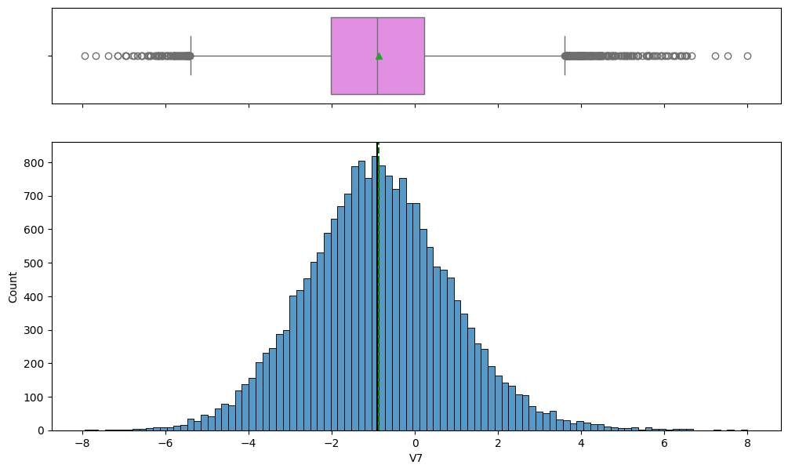
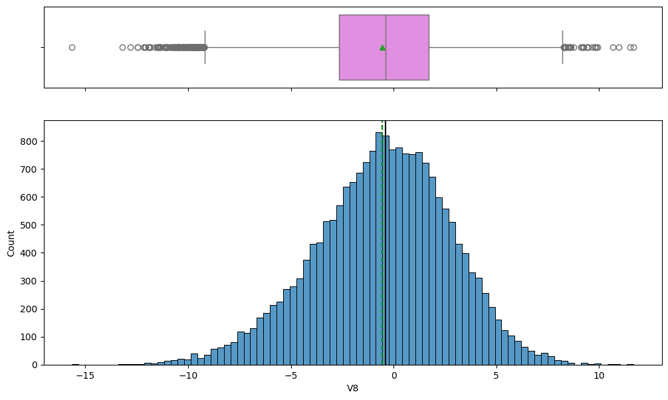
EDA Results- Univariate analysis
Below box and histogram plots shows the distribution and statistics for feature V7 and V8.
Key Observations –V7
High Symmetry: The histogram is very well-balanced with the mean and median nearly identical and centered slightly below zero, suggesting minimal skewness.
Standardized Distribution: The bell curve shape confirms that the feature is standardized and distributed closely to the ideal normal distribution for network input.
Symmetrical Outliers: The box plot shows outliers are distributed symmetrically on both the positive and negative extremes, indicating a consistent, wide range of data points.
Key Observations –V8
High symmetry and centering: The histogram is highly symmetrical and centered near zero, with the mean approximately equal to the median, indicating the feature is optimally standardized.
Ideal normal shape: The distribution closely follows a classic bell curve, confirming it is well-suited as input for a neural network without the need for further transformation.
Symmetrical and wide outliers: The box plot displays several outliers extending symmetrically on both sides, covering a broad range of approximately -10 to +10.

Slide 15
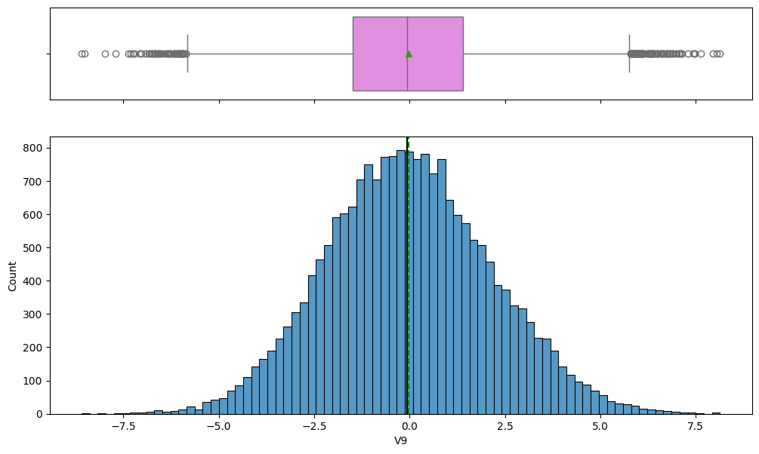
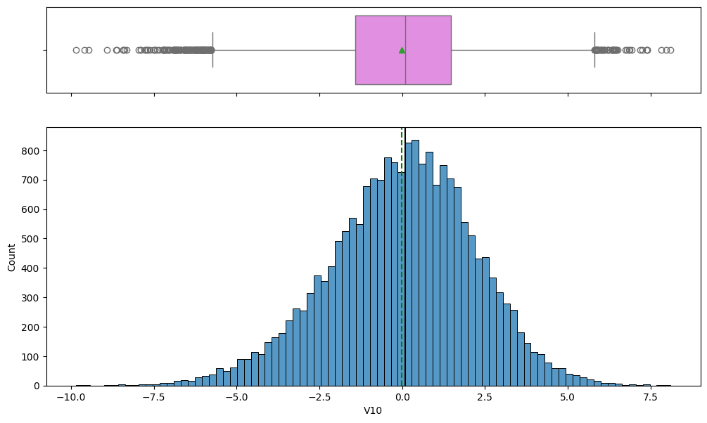
EDA Results- Univariate analysis
Below box and histogram plots shows the distribution and statistics for feature V9 and V10.
Key Observations –V9
Optimal standardization: The distribution is highly symmetrical and perfectly centered around zero, with the mean approximately equal to the median, indicating the feature is ideally standardized.
Classic normal distribution: The histogram closely mirrors a bell curve, confirming that the feature follows a standard normal distribution, making it well-suited for neural network inputs.
Low outlier impact: Although outliers are present, they are symmetrically distributed and do not noticeably affect the central tendency, indicating minimal need for explicit outlier treatment.
Key Observations –V10
High standardization: The feature is highly symmetrical and centered near zero, with the mean approximately equal to the median, indicating optimal Z-score standardization.
Ideal input shape: The histogram closely follows a classic bell curve, confirming that the feature is normally distributed and well-suited for neural network inputs.
Symmetrical outliers: Outliers appear on both sides of the box plot, showing the presence of evenly distributed extreme values that do not distort the central tendency.

Slide 16
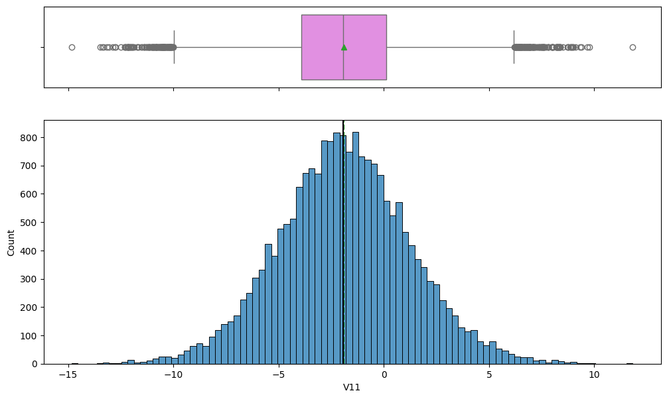
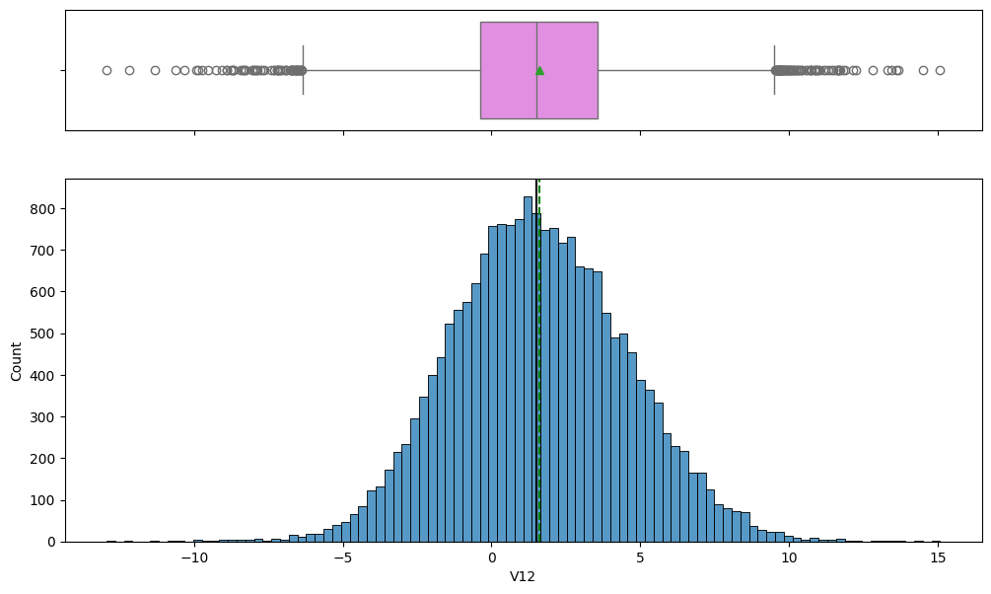
EDA Results- Univariate analysis
Below box and histogram plots shows the distribution and statistics for feature V11 and V12.
Key Observations –V11
Optimal standardization: The distribution is highly symmetrical and centered near zero, with the mean approximately equal to the median, indicating the feature is optimally standardized.
Classic normal distribution: The histogram closely follows the standard bell curve, confirming the feature is normally distributed and well-suited for neural network inputs.
Wider range and symmetrical outliers: The feature spans a broad range, approximately from -15 to +12.5, and shows symmetrically distributed outliers, reflecting high variance without affecting the central tendency.
Key Observations –V12
Optimal standardization: The distribution is highly symmetrical and centered near zero, with the mean approximately equal to the median, indicating the feature is optimally standardized.
Classic normal distribution: The histogram closely aligns with a standard bell curve, confirming that the feature is normally distributed and ideal for neural network inputs.
Wide range and symmetrical outliers: The feature spans a broad range, approximately from -12.5 to +15, and shows symmetrically distributed outliers, indicating high variance without distorting the central tendency.

Slide 17
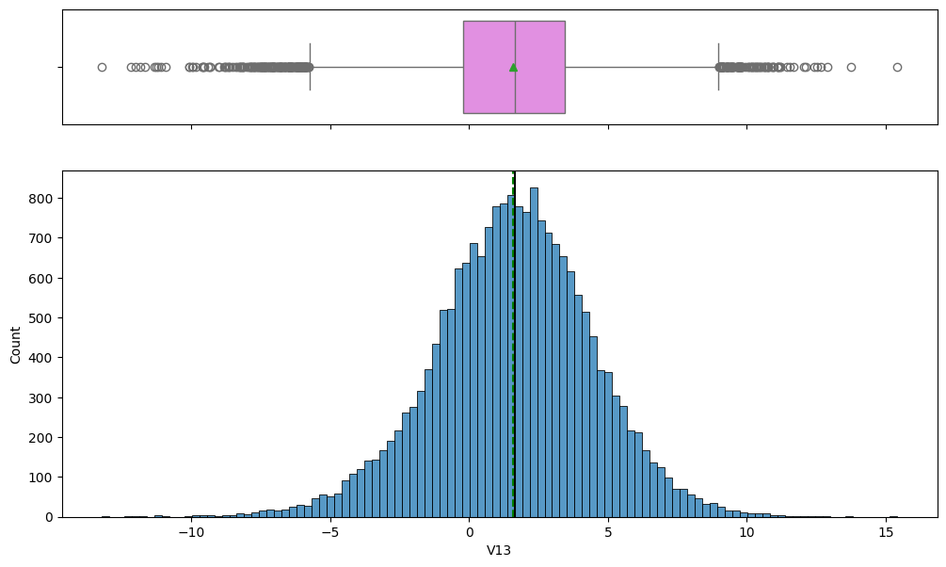
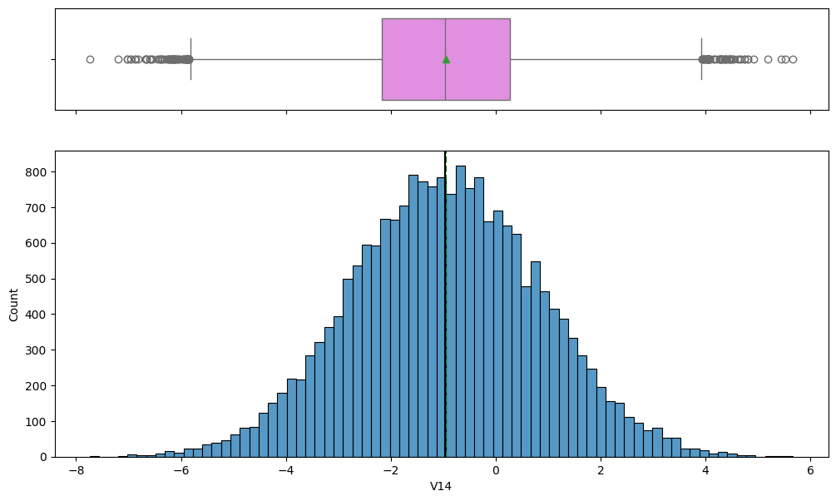
EDA Results- Univariate analysis
Below box and histogram plots shows the distribution and statistics for feature V13 and V14.
Key Observations –V13
Slight positive skew: The mean is slightly to the right of the median, indicating a minor positive skew in the distribution.
Excellent standardization: Despite the slight skew, the distribution remains largely symmetrical and centered near zero, reflecting effective standardization.
Wide range and symmetrical outliers: The feature spans a broad range, approximately from -12.5 to +15, with numerous symmetrically distributed outliers, indicating high variance.
Key Observations –V14
Optimal standardization: The distribution is highly symmetrical and centered near zero, with the mean approximately equal to the median, indicating the feature is ideally standardized.
Classic normal distribution: The histogram closely follows the standard bell curve, confirming that the feature is normally distributed and well-suited for neural network inputs.
Low outlier impact: Although outliers are visible, they are symmetrically distributed and fewer in number compared to other features, indicating a very clean and stable data range.

Slide 18
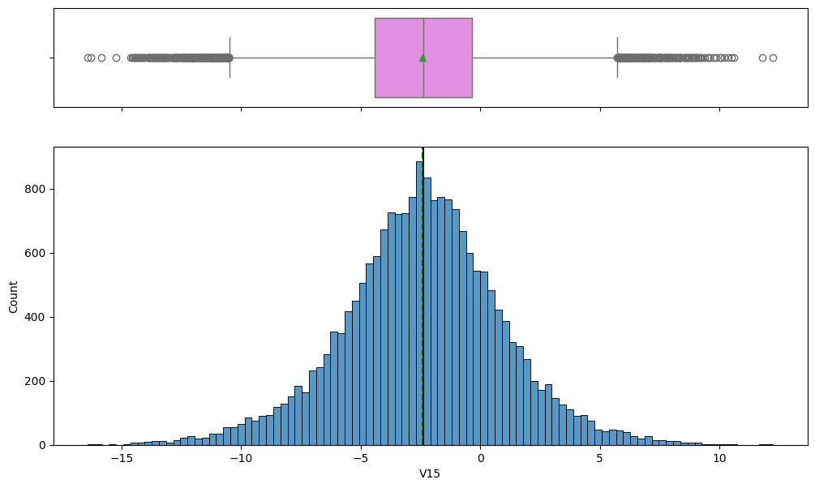
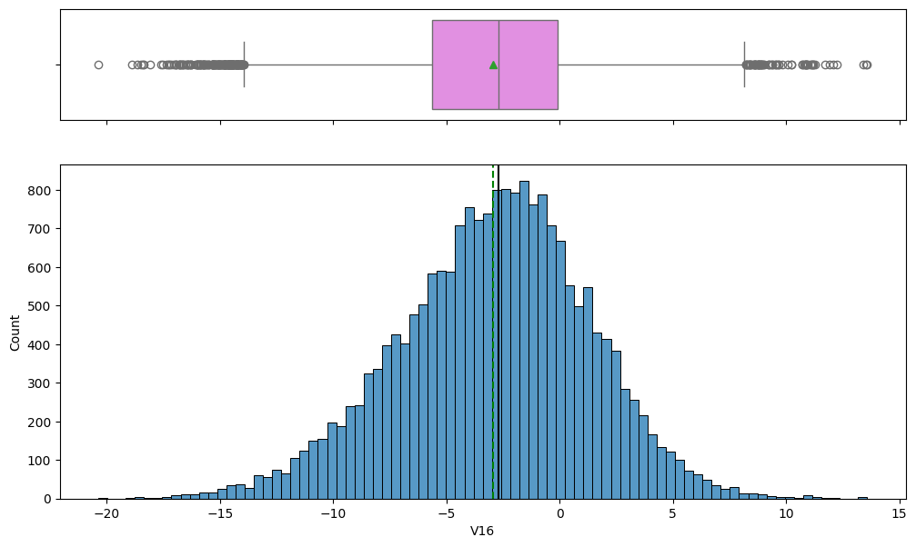
EDA Results- Univariate analysis
Below box and histogram plots shows the distribution and statistics for feature V15 and V16.
Key Observations –V15
Optimal standardization: The distribution is highly symmetrical and centered near zero, with the mean approximately equal to the median, indicating that the feature is ideally standardized.
Classic normal shape: The histogram closely follows the standard bell curve, confirming that the feature is normally distributed and well-suited for neural network input.
Wide range and symmetrical outliers: The feature spans a broad range, approximately from -15 to +12.5, and shows symmetrically distributed outliers, indicating high variance without affecting the central tendency.
Key Observations –V16
Slight negative skew: The mean is slightly to the left of the median, indicating a minor negative skew in the distribution.
Effective standardization: Despite the slight skew, the distribution remains largely symmetrical and centered near zero, reflecting effective standardization.
Very wide range and outliers: The feature spans a much wider range, approximately from -20 to +15, with numerous symmetrically distributed outliers, suggesting high variance across the data.

Slide 19
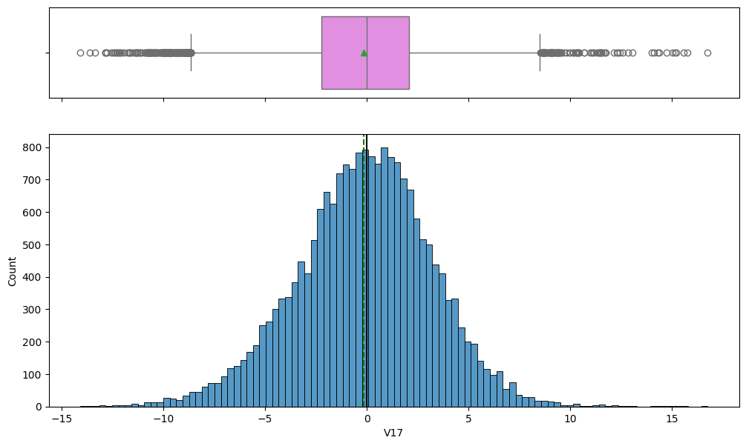
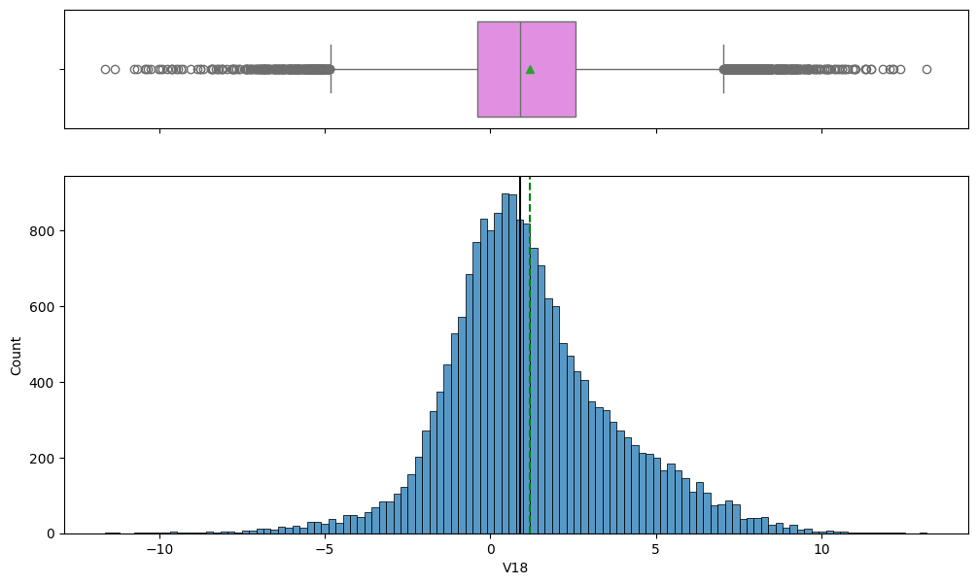
EDA Results- Univariate analysis
Below box and histogram plots shows the distribution and statistics for feature V17 and V18.
Key Observations –V17
Optimal standardization: The distribution is highly symmetrical and centered near zero, with the mean approximately equal to the median, indicating the feature is ideally standardized.
Classic normal distribution: The histogram closely follows the standard bell curve, confirming that the feature is normally distributed and well-suited for neural network inputs.
Wide range and symmetrical outliers: The feature spans a broad range, approximately from -15 to +17.5, and shows symmetrically distributed outliers, indicating high variance without affecting the central tendency.
Key Observations –V18
Slight Positive Skew: The mean (black solid line) is slightly to the right of the median (green dashed line/triangle), indicating a minor positive skew in the distribution.
Effective standardization: Despite the slight skew, the distribution remains largely symmetrical and centered near zero, reflecting effective standardization.
Wide Range and Symmetrical Outliers: The feature has a wide range (approx. -12.5 to +12.5) and exhibits symmetrically distributed outliers, suggesting high variance.

Slide 20
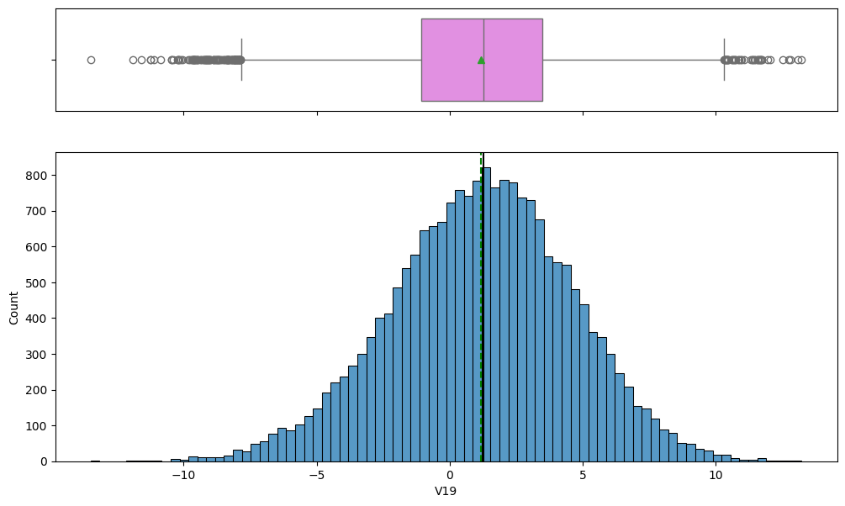
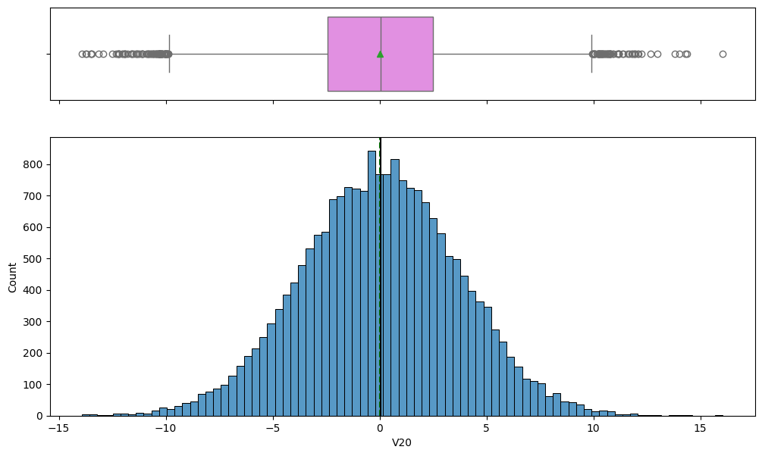
EDA Results- Univariate analysis
Below box and histogram plots shows the distribution and statistics for feature V19 and V20.
Key Observations –V19
Optimal Standardization: The distribution is highly symmetrical and centered very close to zero (mean is approximately equal to median is approximately equal to 0), indicating the feature is optimally standardized.
Classic Normal Shape: The histogram closely matches the standard bell curve shape, confirming that the feature is normally distributed and is an ideal input for the Neural Network.
Symmetrical Outliers: Outliers are clearly present on both the positive and negative sides of the box plot whiskers, suggesting symmetrically distributed extreme values within the data range
Key Observations –V20
Optimal Standardization: The distribution is highly symmetrical and centered very close to zero (mean is approximately equal to median is approximately equal to 0), indicating the feature is ideally standardized.
Classic Normal Distribution: The histogram perfectly matches the standard bell curve shape, confirming the feature is normally distributed, which is ideal for Neural Network inputs.
Wide Range and Symmetrical Outliers: The feature spans a very wide range (approx. -15 to +17.5) and exhibits symmetrically distributed outliers, suggesting high variance without central tendency distortion.

Slide 21
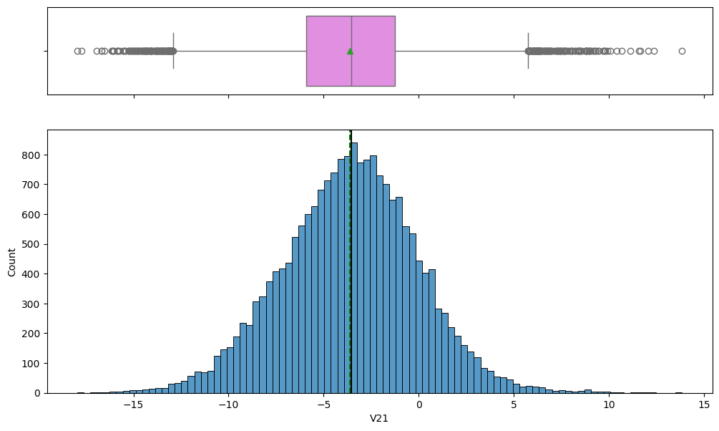
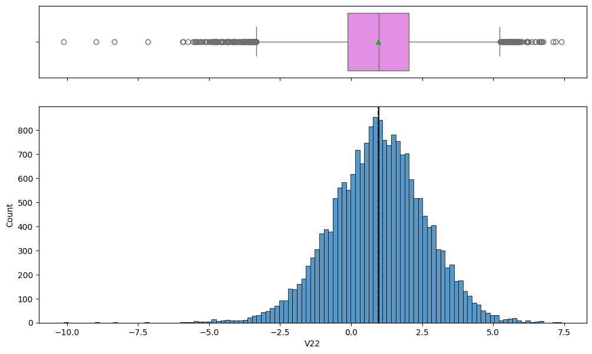
EDA Results- Univariate analysis
Below box and histogram plots shows the distribution and statistics for feature V21 and V22.
Key Observations
The distribution of V22 (top image) appears slightly positively skewed, with a mean/median around 1.0.
The distribution of V21 (bottom image) appears to be approximately symmetric and centered near -3.0.
V22 has a smaller spread or standard deviation than V21, as its histogram is narrower.
Both distributions contain a significant number of outliers, indicated by the circles in their respective box plots.

Slide 22
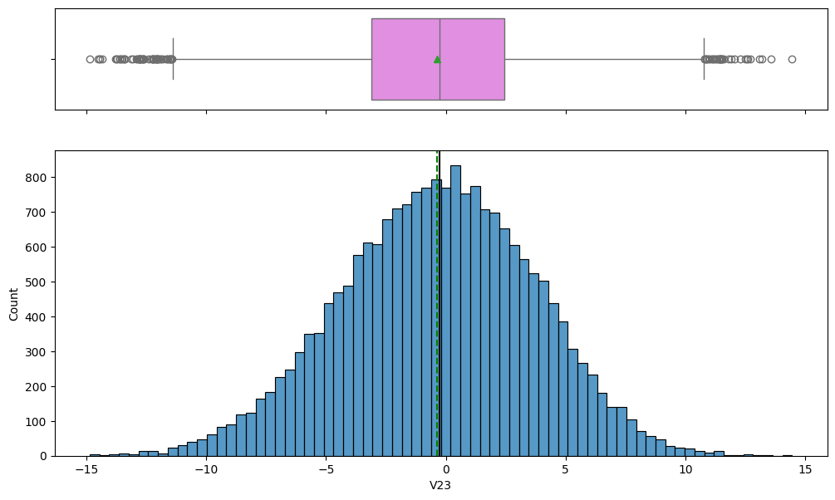
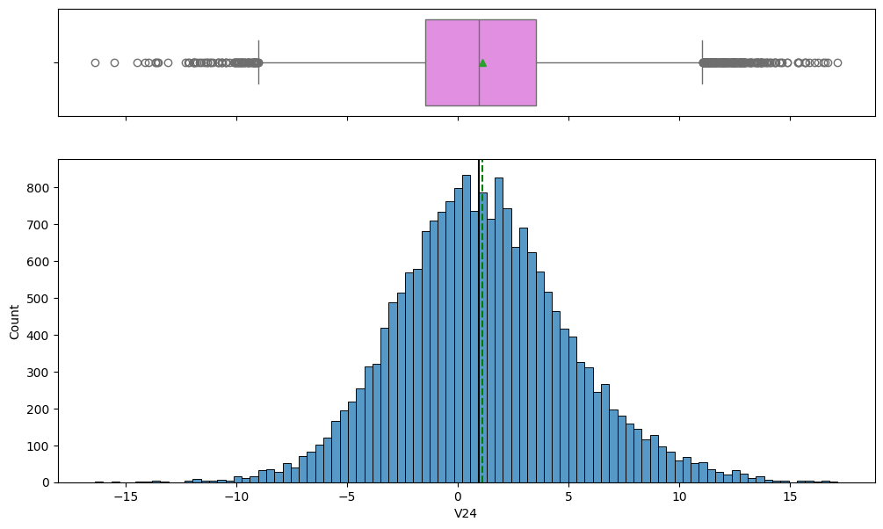
EDA Results- Univariate analysis
Below box and histogram plots shows the distribution and statistics for feature V23 and V24.
Key Observations
The distribution of V23 (bottom image) is highly symmetric and bell-shaped, centered very close to zero.
The distribution of V24 (top image) is also approximately symmetric and bell-shaped, centered slightly positively near 1.0.
Both V23 and V24 have a similar spread or range of values, suggesting similar variability.
Both variables exhibit a large number of outliers in their tails, which are visible as circles outside the whiskers of the box plots.

Slide 23

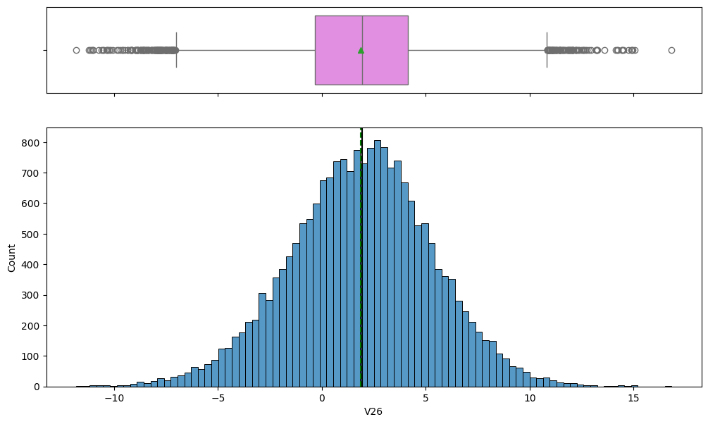
EDA Results- Univariate analysis
Below box and histogram plots shows the distribution and statistics for feature V25 and V26.
Key Observations
The distribution of V25 (top image) is highly symmetric and bell-shaped, centered very close to zero.
The distribution of V26 (bottom image) is also symmetric but is centered slightly positively, around 1.5.
V26 has a wider spread (larger range of values) than V25, indicating greater variability.
Both V25 and V26 exhibit a large number of outliers in their tails, which are clearly marked in the box plots.

Slide 24
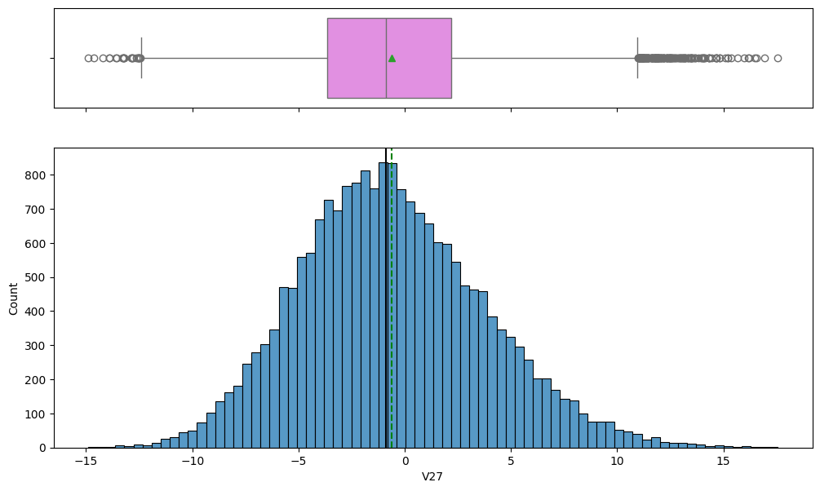
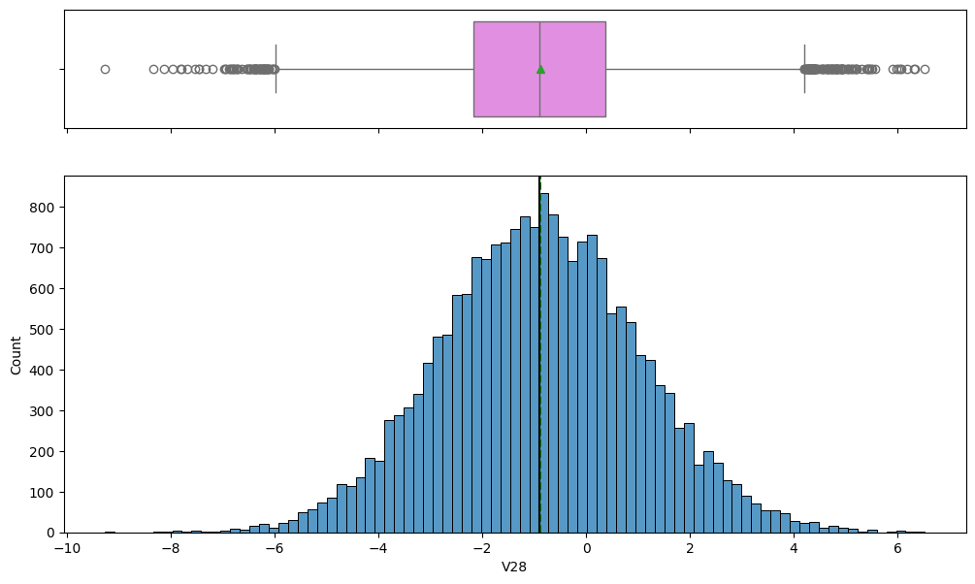
EDA Results- Univariate analysis
Below box and histogram plots shows the distribution and statistics for feature V27 and V28.
Key Observations
The distribution of V27 (top image) is symmetric and bell-shaped, centered very close to zero.
The distribution of V28 (bottom image) is also symmetric and bell-shaped, but is centered slightly negatively, around -1.0.
V27 shows a wider spread (larger range of values) than V28, indicating V27 has greater variability.
Both V27 and V28 exhibit a large number of outliers in their tails, which are shown as circles in the box plots.

Slide 25

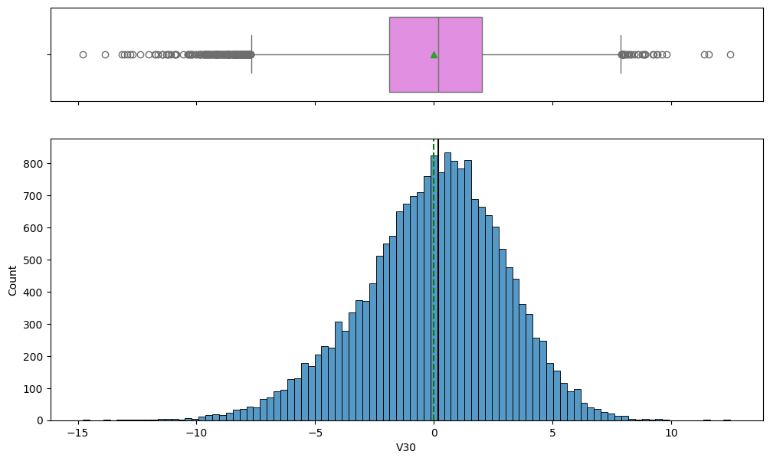
EDA Results- Univariate analysis
Below box and histogram plots shows the distribution and statistics for feature V29 and V30.
Key Observations
The distribution of V29 (top image) is approximately symmetric and bell-shaped, centered very close to zero.
The distribution of V30 (bottom image) is also approximately symmetric and bell-shaped, centered slightly positively near 0.5.
V30 has a wider spread (larger range of values) than V29, indicating V30 has greater variability.
Both variables exhibit a significant number of outliers in their tails, which are clearly visible in the box plots.

Slide 26
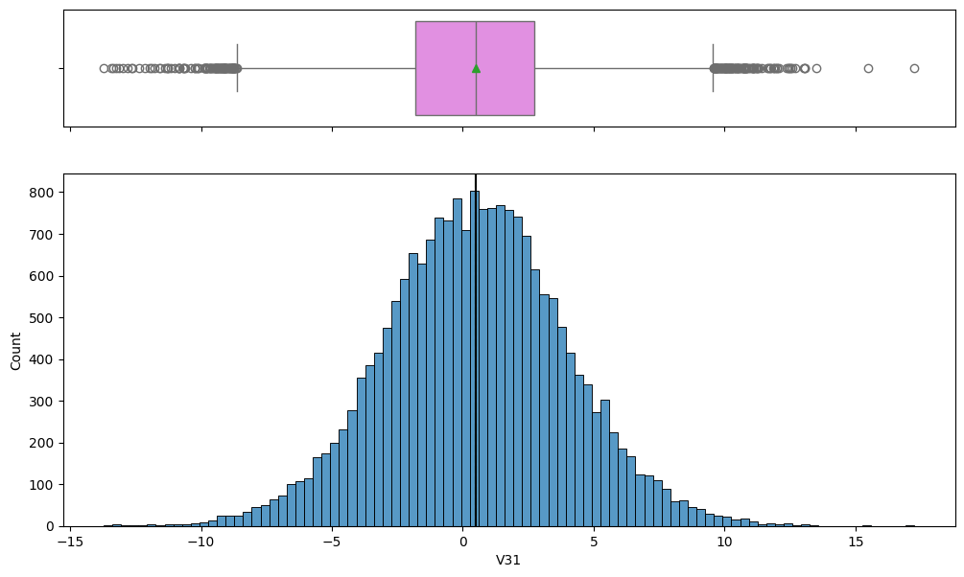
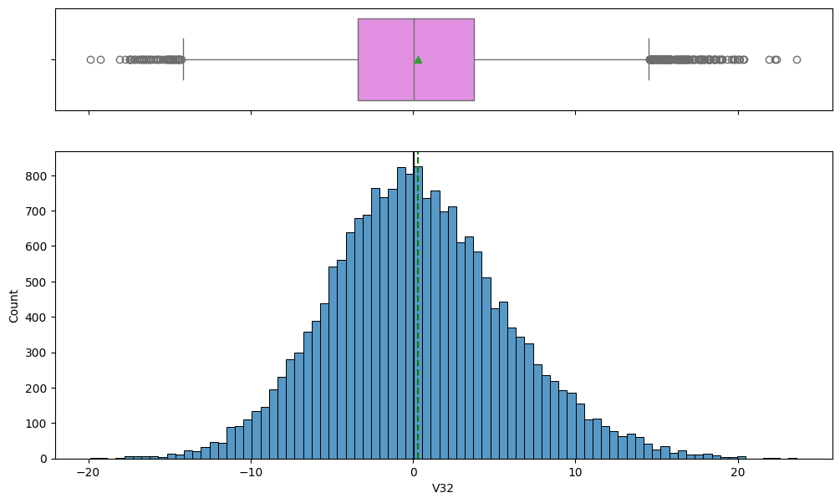
EDA Results- Univariate analysis
Below box and histogram plots shows the distribution and statistics for feature V31 and V32.
Key Observations
The distribution of V31 (top image) is highly symmetric and bell-shaped, centered very close to zero.
The distribution of V32 (bottom image) is also highly symmetric and bell-shaped, centered very close to zero.
V32 has a wider spread (larger range of values) than V31, indicating greater variability in V32.
Both variables exhibit a large number of outliers in their tails, which are clearly marked in the box plots.

Slide 27

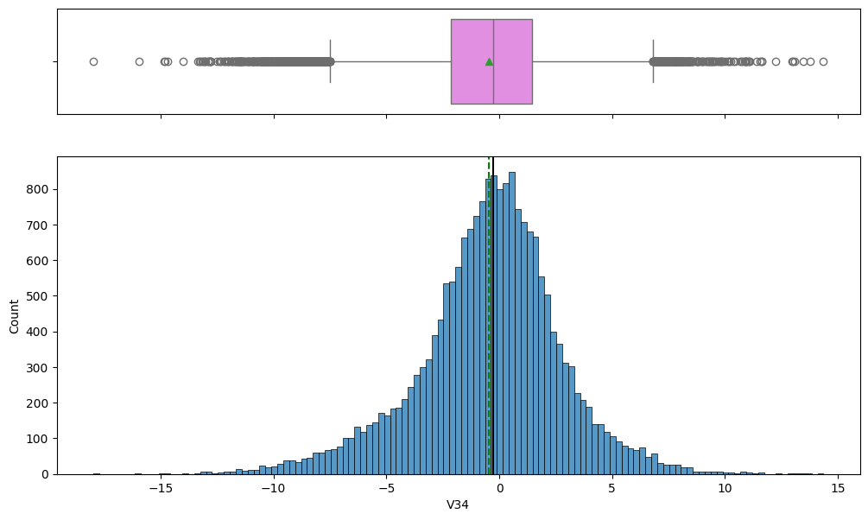
EDA Results- Univariate analysis
Below box and histogram plots shows the distribution and statistics for feature V33 and V34.
Key Observations
The distribution of V33 (top image) is highly symmetric and bell-shaped, centered very close to zero.
The distribution of V34 (bottom image) is also highly symmetric and bell-shaped, centered very close to zero.
V33 has a wider spread (larger range of values) than V34, indicating greater variability in V33.
Both variables exhibit a large number of outliers in their tails, which are clearly marked in the box plots.

Slide 28
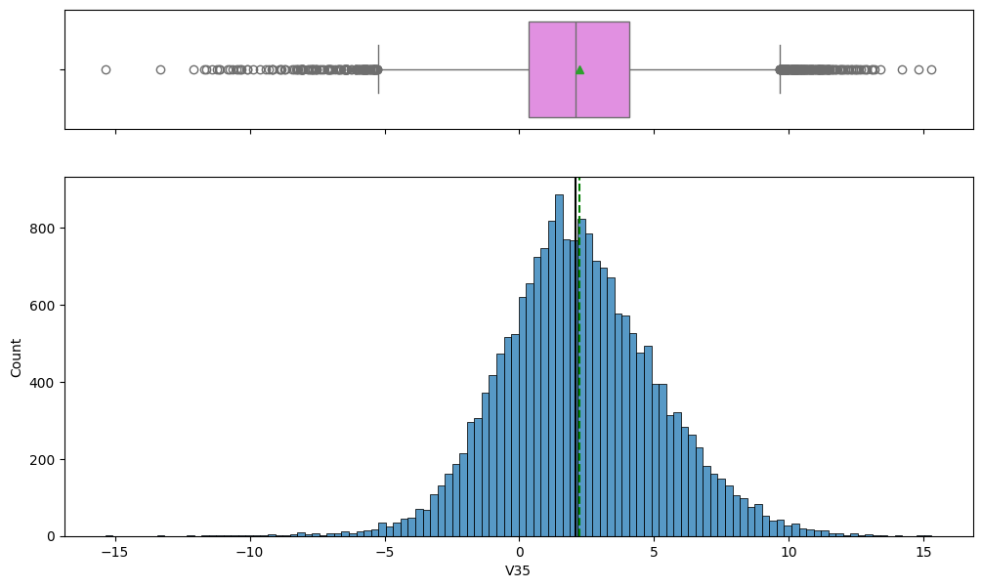
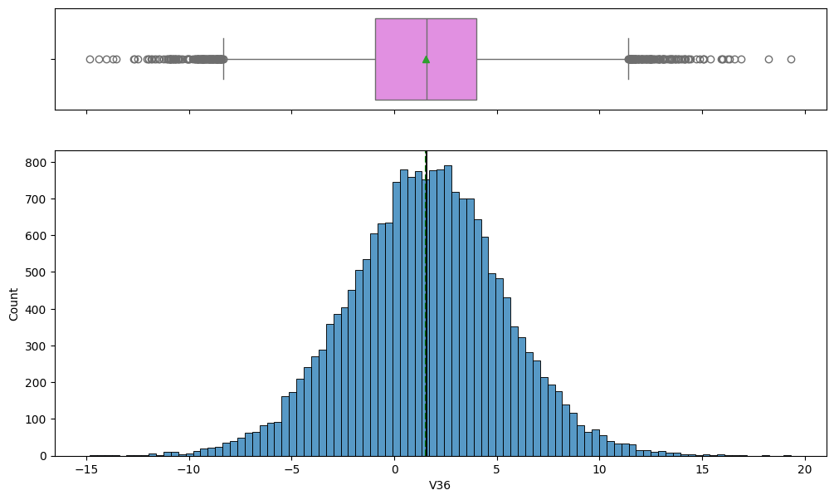
EDA Results- Univariate analysis
Below box and histogram plots shows the distribution and statistics for feature V35 and V36
Key Observations
The distribution of V35 (bottom image) is approximately symmetric and centered slightly positively, around 2.0.
The distribution of V36 (top image) is also approximately symmetric and centered slightly positively, around 2.0.
V36 has a wider spread (larger range of values) than V35, indicating greater variability in V36.
Both variables exhibit a large number of outliers in their tails, which are clearly marked in the box plots.

Slide 29
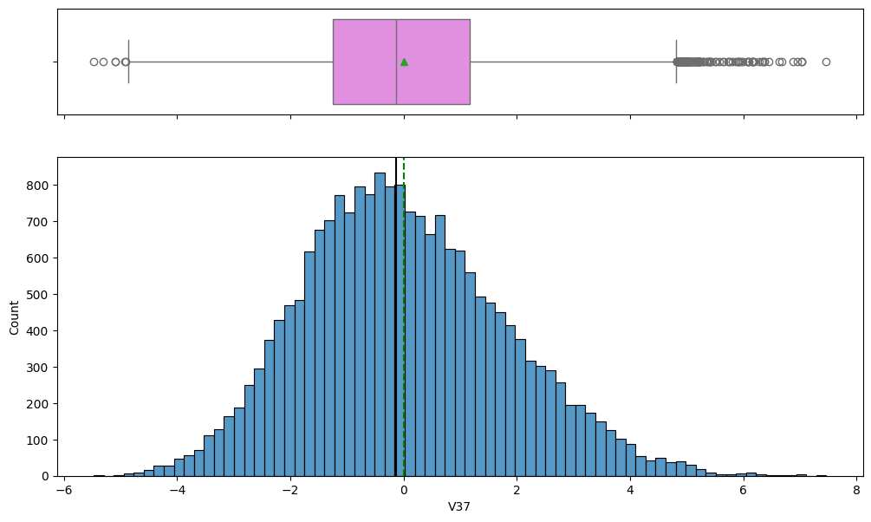
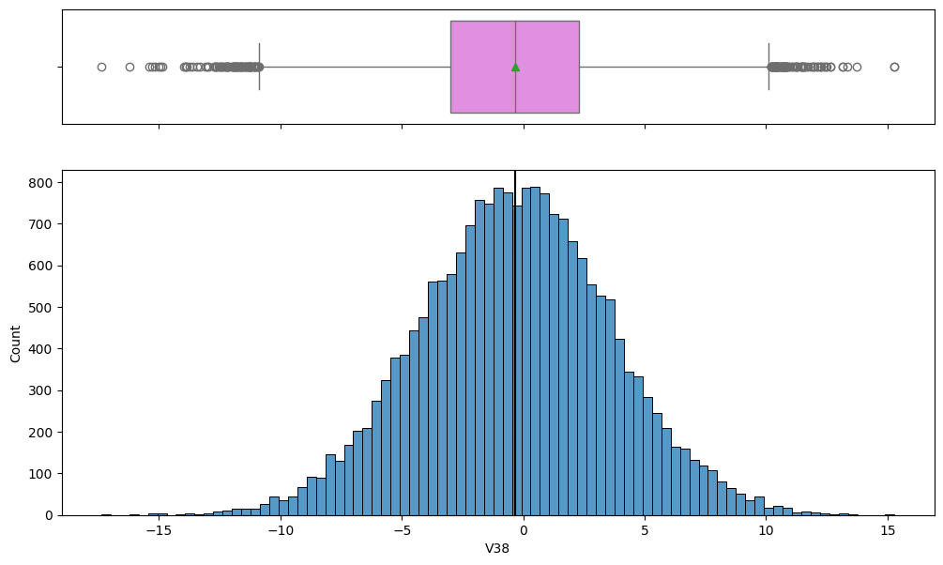
EDA Results- Univariate analysis
Below box and histogram plots shows the distribution and statistics for feature V37 and V38
Key Observations
The distribution of V37 (bottom image) is approximately symmetric and centered very close to zero.
The distribution of V38 (top image) is also highly symmetric and bell-shaped, centered very close to zero.
V38 has a significantly wider spread (larger range of values) than V37, indicating much greater variability in V38.
Both variables exhibit a large number of outliers in their tails, which are clearly marked in the box plots.

Slide 30
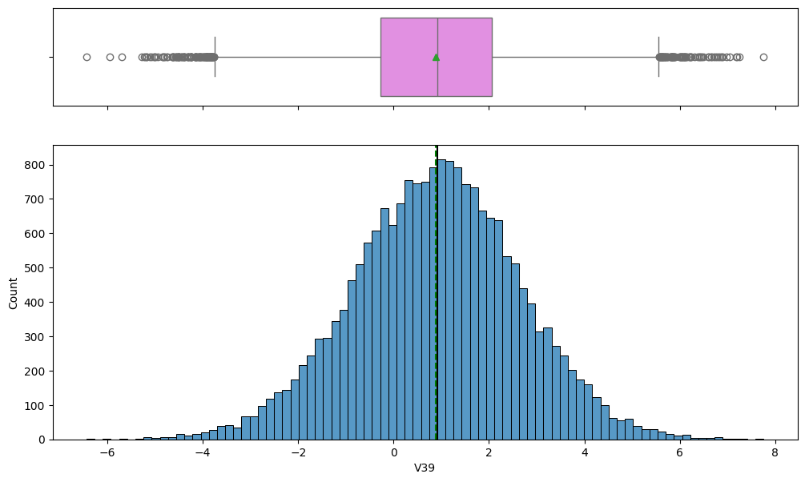
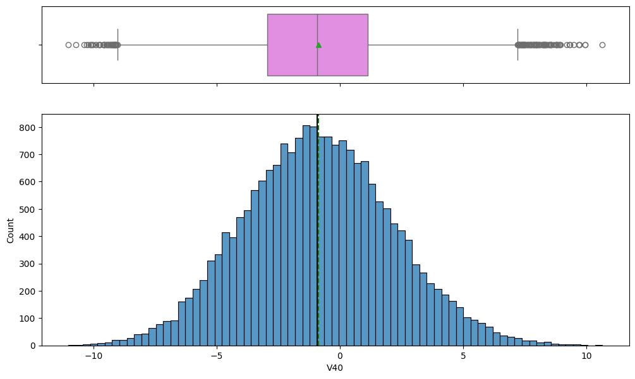
EDA Results- Univariate analysis
Below box and histogram plots shows the distribution and statistics for feature V39 and V40
Key Observations
The distribution of V39 (top image) is approximately symmetric and centered slightly positively, around 0.5.
The distribution of V40 (bottom image) is highly symmetric and bell-shaped, centered very close to zero.
V40 has a wider spread (larger range of values) than V39, indicating greater variability in V40.
Both variables exhibit a large number of outliers in their tails, which are clearly visible in the box plots..

Slide 31
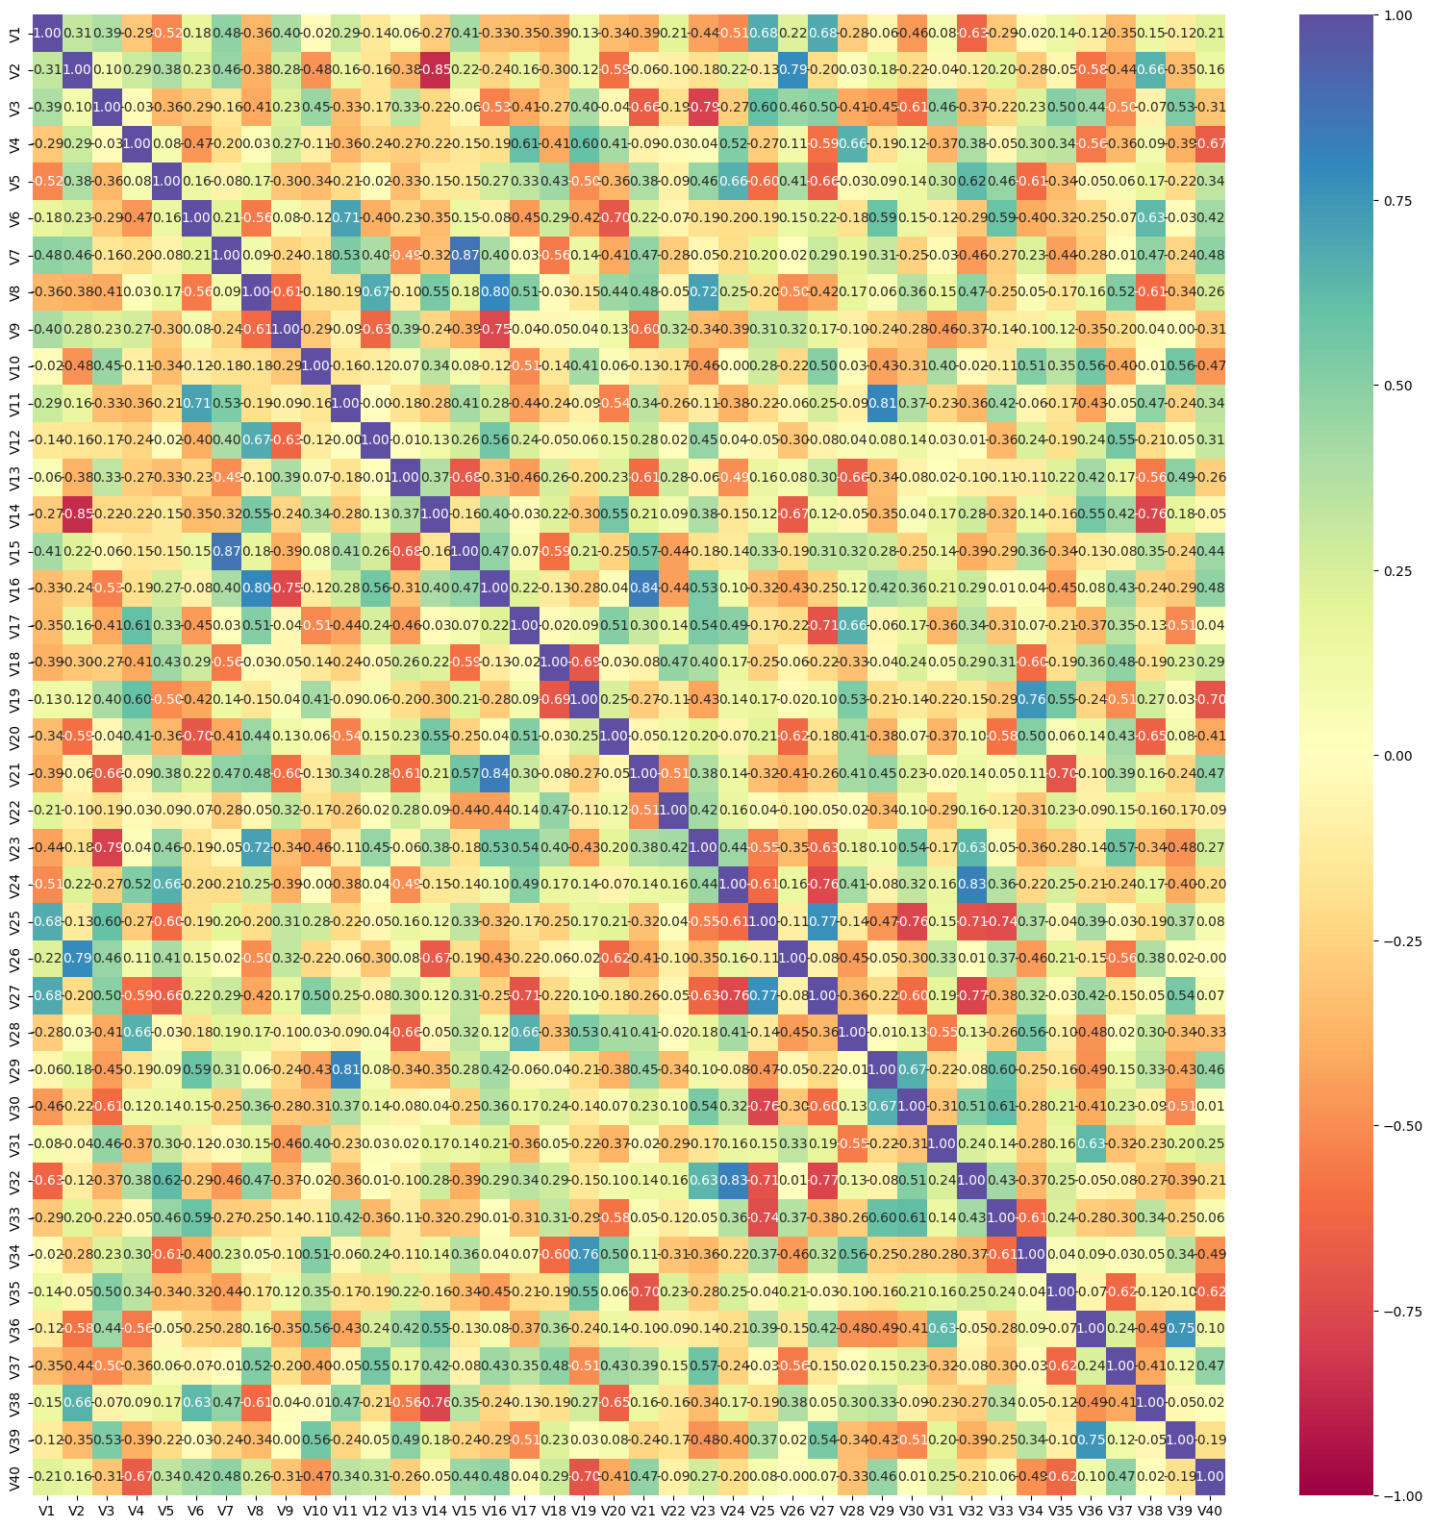
EDA Results(Bivariate Analaysis) -Correlation Matrix heatmap
This plot is a Correlation Matrix heatmap showing the linear relationship between the features (V1 through V40).
Key Observations
No extreme multicollinearity: Most of the plot shows light green or yellow areas, indicating no strong linear dependence between features.
Expected self-correlation: The diagonal line is dark blue with a value of 1.00, confirming that each variable is perfectly correlated with itself.
Few moderate positive pairs: A small number of feature pairs show moderate positive correlation, light blue patches (V19/v20) but none are high (>=0.8).
Absence of strong negative correlation: There are no deep red areas, indicating no strong inverse relationships between features.
Data suitability for neural networks: The overall low inter-feature correlation suggests the data is appropriate for neural network modeling, reducing redundancy-related issues.

Slide 32
Data Preprocessing
Duplicate value check : Trained data do not have duplicate data
Missing value
  Trained Data set: There are 18 missing values in V1 and V2 features
  Test Data set : There are 5 missing values in V1 and 6 missing values in V2 features
  Missing value treatment
    Missing values were handled using the median imputation technique to ensure robustness against outliers.
    To prevent data leakage, imputation was performed after splitting the dataset into training and validation subsets.
    A SimpleImputer (strategy = 'median') was fitted on the training data and subsequently applied to the validation and test datasets using the same imputer instance.
    This approach ensures consistent transformation across all data partitions while maintaining model integrity

Slide 33
Outlier Analysis
Outliers Exist Broadly: All features exhibit a wide range between min/max and the 25%/75% quartiles, confirming the presence of outliers in every variable.
Symmetrical Outliers are Common: For features like V4, V17, and V33, the distance from the median (50%) to the min and max is roughly symmetrical, suggesting two-sided outliers.
Positive Outliers are Extreme: Feature V32 has the largest max value(23.633) which is significantly farther from its 75% quartile (3.761) than the min is from its 25 % indicating extreme positive outliers
Negative Outliers are Extreme: Feature V16 has the lowest min value (-20.374), showing that it contains some of the most extreme negative outliers in the dataset.

Slide 34
Feature Engineering and Data prepartion for modeling
Data Splitting
  Trained data set is splitted for Training Data and Validation Dataset in ratio of (8;2)
  Splitting for Test Set is not required as Test Data Set is provided
  Random_state=1 is used in order to ensure Reproducibility
  stratify=y to ensure to validation set is a true miniature representation of entire dataset's class distribution
Final Shape of the DataSet after the splitting of the Training and Validaion datasets
  Traing DataSet: (16000,40)
  Validation DataSet : (4000,40)
  Training DataSet: (5000,40)

Slide 35
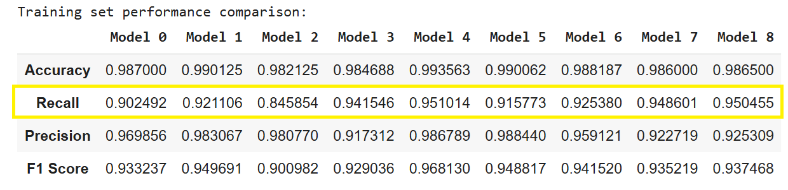
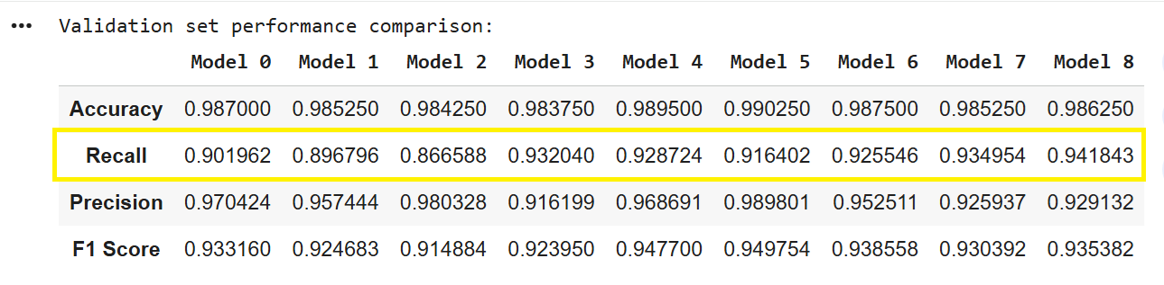
Model Evaluation Criterion-Performance Metric Comprasion
Note:
Rational model_7 and model_8
During the review of model_6, I observed that the optimizer used was SGD, and the model was incorrectly fitted using the model_3 configuration. I did that correction and Model_6 got executed
In my initial comparison I found Model_3 and Model_6 was the best model which I built with (28->14->7 neuron ) ,I built model_7 on top of model 6 (with Adam optimizer )and increase the number of neurons in hidden layers(40→20→10) to check if overall performance improved
Additionally, I built Model_8 by increasing the number of neurons(40→20->10) on top of the model_3(with SGD Optimizer) to analyze training and validation performance, aiming to explore potential performance improvements.

Slide 36
Step by Step Model Evaluation
Recall Comparison –Primary Metric
Models | Train Recall | Validation Recall | Generalization Gap
Model0 | 0.9025 | 0.9020 | 0.0005
Model1 | 0.9211 | 0.8968 | 0.0243
Model2 | 0.8459 | 0.8666 | 0.0207
Model3 | 0.9415 | 0.9320 | 0.0095
Model4 | 0.9510 | 0.9287 | 0.0223
Model5 | 0.9158 | 0.9164 | -0.0006
Model6 | 0.9254 | 0.9255 | -0.0001
Model7 | 0.9486 | 0.9350 | 0.0136
Model 8 | 0.9505 | 0.9418 | 0.0087
Top Recall Models –Validation
Model _8→ 0.9418
Model_7→0.9350
Model_3→0.9320
Model_6→0.9255
Observation :
Model_8 achieves the highest validation Recall, closely followed by Models 7 and 3.

Slide 37
Step by Step Model Evaluation
Accuracy and Precision –Stability
Models | Train Precision | Validation Precision | Delta(Gap) Precision
Model_8 | 0.9253 | 0.9291 | 0.0038
Model_7 | 0.9227 | 0.9259 | 0.0023
Model_3 | 0.9173 | 0.9162 | -0.0011
Model_6 | 0.9591 | 0.9525 | -0.0066
Observation on Stability
All four top Recall models maintain excellent Precision stability between training and validation sets, indicating good generalization.
F1 Score-Balance Check
Observation on Balance Check
F1 scores are tightly aligned between training and validation — showing no sign of overfitting.
Model 6 slightly edges others on F1 balance, but Recall (my priority) favors Model 8.
Models | Train F1 | Validation F1
Model_8 | 0.9375 | 0.9354
Model_7 | 0.9352 | 0.9304
Model_3 | 0.9293 | 0.9239
Model_6 | 0.9415 | 0.9386

Slide 38
Final Model Recommndation –Model_8
Rationale :
Metric | Observation
Primary Metric (Recall) | Highest validation Recall (0.9418) with very close training Recall (0.9505), indicating strong generalization.
Precision | Stable across training and validation
F1 Score | High and consistent (Train: 0.9375, Val: 0.9354).
Accuracy | Among the top (Train: 0.9865, Val: 0.9863).
Overfitting Check | Minimal gaps across all metrics → model generalizes extremely well.
Conclusion –Summary
Based on a comparative assessment of all performance metrics, with Recall prioritized, Model 8 emerges as the best-performing model.
It provides the highest validation Recall (0.9418) while maintaining excellent Precision (0.9291) and consistent F1-scores, demonstrating a strong balance between sensitivity and reliability.
Models 7 and 6 are close contenders, but Model 8 shows the best trade-off between Recall strength and generalization stability.

Slide 39
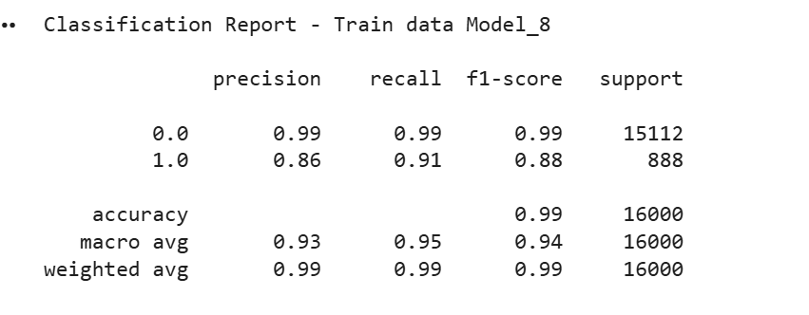
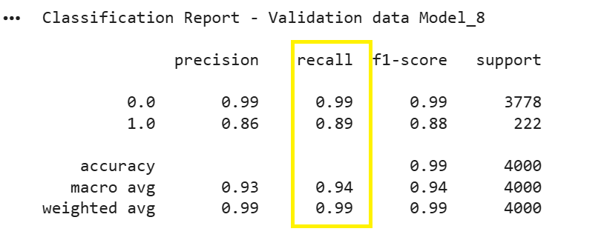
Best Model_8 Classifaction Reports
Key Insights
Strong Generalization with Minimal Performance Drop: The model maintains nearly identical performance across training and validation sets, with macro-averaged F1-scores of 0.94 (train) and 0.94 (validation), confirming that the model generalizes effectively without overfitting.
High Recall for Minority Class (Class 1): With Recall values of 0.91 (train) and 0.89 (validation), Model 8 successfully identifies the majority of positive class instances, aligning perfectly with the primary goal of maximizing sensitivity.
Balanced Precision–Recall Trade-off: Precision for the minority class remains steady at 0.86 across both datasets, demonstrating that the improvement in Recall is not achieved at the expense of excessive false positives — a well-balanced classification outcome.
Excellent Overall Model Stability: The accuracy of 0.99 on both training and validation data, combined with consistent weighted averages, reflects the model’s robustness and its ability to maintain predictive reliability across unseen data.
High Performance Across Both Classes: Both majority (0.0) and minority (1.0) classes exhibit high F1-scores (~0.99 and 0.88, respectively), confirming that the model performs exceptionally well on both common and rare events, ensuring dependable classification outcomes.

Slide 40
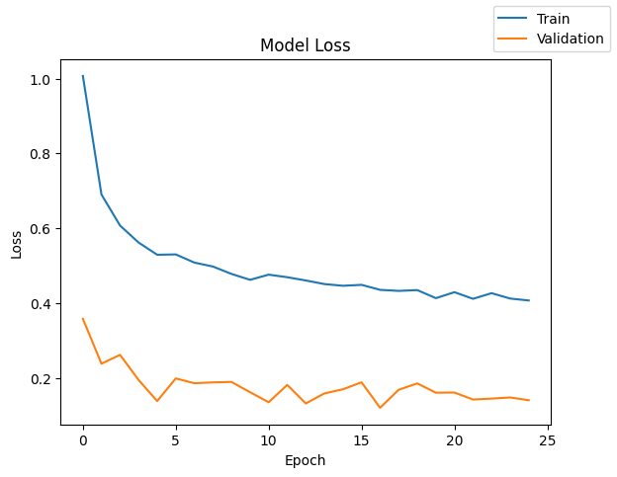
Best Model_8 Loss
Key Insights
Rapid Initial Learning: Both Train and Validation loss drop significantly in the first few epochs (0-5), indicating the model is effectively learning the fundamental patterns early on.
Significant Overtraining/Overfitting: The Train loss is consistently and substantially higher than the Validation loss across most epochs, which is the opposite of typical overfitting and suggests a potential data distribution or metric issue.
Stable Validation Performance: The Validation loss quickly reaches a relatively low and stable value (around 0.15-0.20) after the initial drop, suggesting good generalization on the holdout set.
Plateaued Training Loss: The Train loss decreases slowly after the initial drop and plateaus around epoch 10-15 (at about 0.4-0.45),

Slide 41




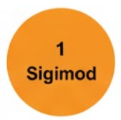
Best Model_8 Architecture
This model_8 Architecture is a Shallow Feedforward Deep Neural Network ( designed for a binary classification task on structured data.
Dens1 Layer
40 Neurons
Activation : Relu
Input Layer (X_Train)
Features:40
Dropout Layer
50 %
Dens2 Layer
20 Neurons
Activation : Relu
Dens3 Layer
10 Neurons
Activation : Relu
Output Layer
1 Neurons
Activation : Sigmoid
Classification : Output P Class(1)
Key Features:
Funneling Architecture: The network uses a decreasing number of neurons across its hidden layers (40→20→10) This progressive reduction is a common technique to force the network to learn more compact and abstract representations of the input data, enhancing feature extraction and reducing complexity
ReLU for Non-Linearity : The use of ReLU in all hidden layers is standard practice. It provides computational efficiency and helps mitigate the vanishing gradient problem in deeper networks.
Binary Output: The final layer is a single neuron with a Sigmoid activation function, which outputs the necessary probability score (P(Class 1)) for binary classification.
Targeted Optimization: The combination of setting the primary metric Recall and using class_weight shows a deliberate, professional strategy to optimize model performance specifically for imbalanced data, which was necessary given your analysis.
Training Configurations
Loss Function | Binary_crnecprerssx
Optimizer | Adam
Evaluation Metric | Recall
Epoch | 25
Batch Size | 32
Regularization | Dropout 50 %
Bias Mitigation | Class_wight=cw_dict

Slide 42
Best Model_8 - Test Performance
Test Set Performance Metrics
Accuracy | Recall | F1 Score | Precision
0984 | 0.935 | 0.921 | 0.925
Key Comment on Model 8-Test performance:
Overall, the performance is strong and confirms its suitability for production, but with a slight, expected drop in the primary metric, Recall.2.
Strong Generalization Confirmed: The test accuracy of 0.984 aligns closely with training and validation results, confirming that the model generalizes exceptionally well and maintains stable performance on unseen data.
High Sensitivity Maintained (Primary Metric):The model achieves a Recall of 0.935, demonstrating its strong ability to correctly identify the positive class, consistent with its design objective of maximizing Recall.
Balanced Precision–Recall Trade-off: A Precision of 0.921 alongside the high Recall indicates the model effectively limits false positives while capturing nearly all true positives, resulting in a well-balanced performance.
Strong Overall Predictive Balance (F1 = 0.925):The F1-Score reflects a harmonious balance between Precision and Recall, highlighting the model’s reliability across both sensitivity and specificity aspects.
Consistent End-to-End Model Stability:Minimal deviation across train, validation, and test metrics indicates excellent model robustness and no overfitting, confirming Model 8’s suitability for deployment in production environments.

Slide 43
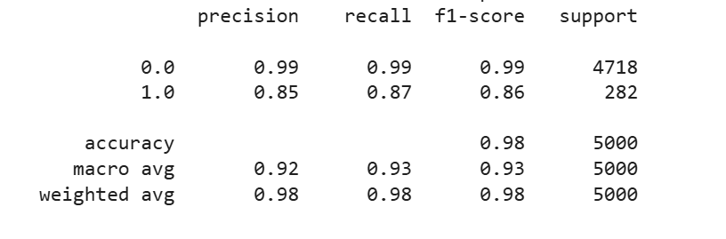
Best Model_8 – Classifaction Report for Test Performance
Observations and Comment :
Excellent Overall Accuracy and Stability: The model achieves a high overall accuracy of 0.98, consistent with its training and validation results, confirming excellent generalization and stability on unseen data.
Strong Sensitivity on Minority Class (1.0):A Recall of 0.87 for the positive class indicates the model’s strong ability to correctly identify true positives, reinforcing its effectiveness for use cases where minimizing false negatives is critical.
Well-Balanced Precision–Recall Trade-off: The Precision (0.85) and Recall (0.87) for the minority class are well-aligned, resulting in a balanced F1-score of 0.86, which shows the model’s reliability in managing both false positives and false negatives effectively.
Consistent Class-Wise Performance: Both majority (0.0) and minority (1.0) classes exhibit strong F1-scores (0.99 and 0.86, respectively), confirming that Model 8 performs consistently across classes despite data imbalance.
Robust Generalization Confirmed Across All Stages:
The macro-average F1-score of 0.93 and weighted-average F1-score of 0.98 closely match prior validation results, highlighting that Model 8 maintains its predictive integrity and balanced classification capability from training to deployment.
    Conclusion :
    Model 8 is production ready for ReneWind Production : t achieves a highly desirable Reacll for the Miniority Class 0.87 while maintaining extremely high overall performance metrics

Slide 44
APPENDIX

Slide 45
Slide Header
Please add any other pointers (if needed)

